Slide 1


Marine Composites Inspection Workshop 2021
Poole, October 14th
Recent Advances in Microwave NDE/NDT Systems
  Prof Rob Sloan
  Microwave Inspection Technologies Ltd.
  rob.sloan@mwave-inspect.co.uk

Slide 2

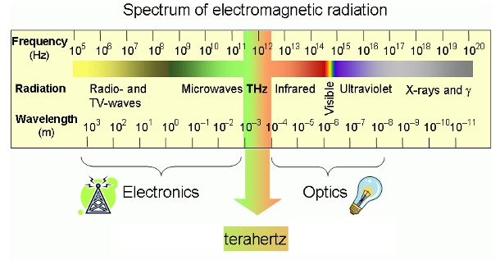
  Microwave NDT/NDE (low GHz to 1000 GHz)
  Primarily for dielectrics such as ceramics, rubber, glasses, polymers and plastics. So a good candidate for marine composites.
  Inspections where ultrasonic or eddy current will not work well either due to absorption (rubber) or scattering caused by mesh or fabrics, or where the materials concerned are not conductors.
  Air coupled – requires no couplant.

Slide 3
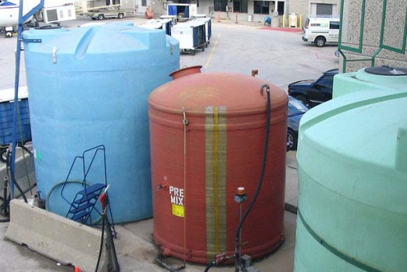
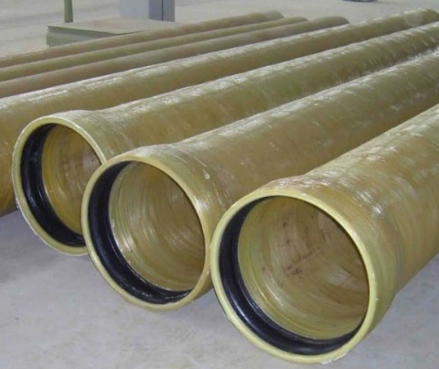
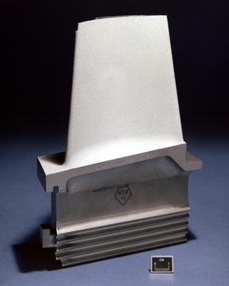
  Example Inspections:
  GFRP Tanks and Structural Laminates
  HDPE Piping
  and Pipe Fusion Joints
  TBC (Ceramic) on Turbine Blades
    Thickness and porosity
    Blistering and delamination
    Cracks hidden beneath the TBC

Slide 4
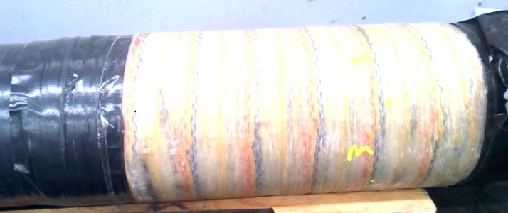
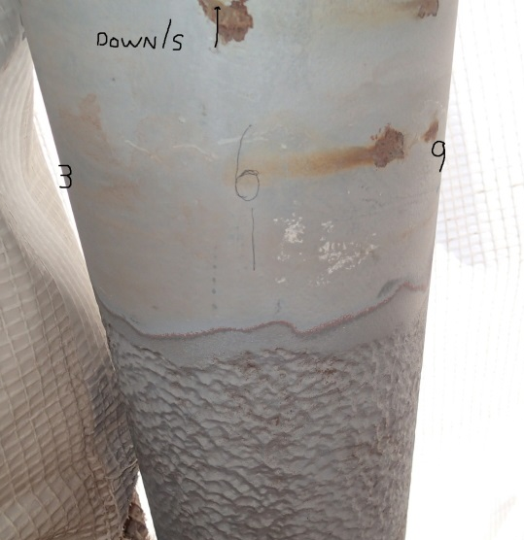
  Wraps and Repairs on Piping and surface finish inspection
Composite wrap repair

Slide 5
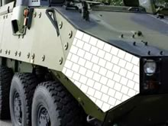
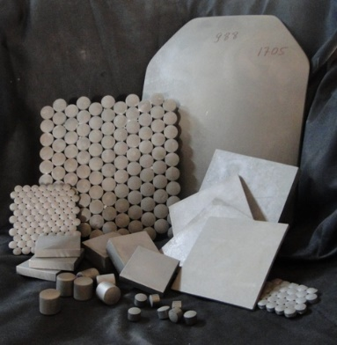
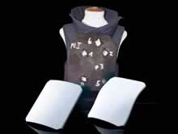
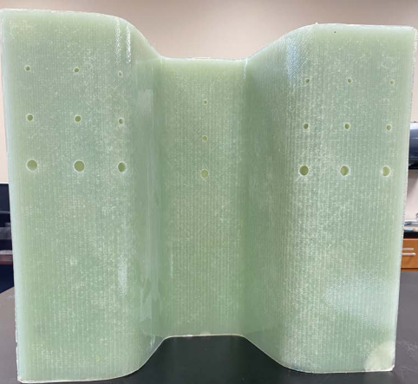
  Example Inspections:
  Ceramic Armour & honeycomb aerospace tiles
  Plus many others…. including marine composites…. E.g. GFRP

Slide 6
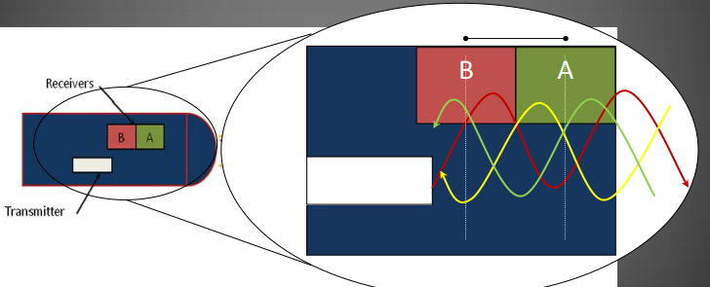
  1st Generation Reflection Based Microwave NDT
  First generation commercial system employed a microwave diode oscillator in a waveguide and detector diodes to reform the resulting microwave standing wave. As used in 24GHz radar technology:
  Receivers A&B detect the standing wave energy so a composite wave made up of forward & reflected waves. Defects are detected through a change in the standing wave.
  Good results have been achieved but issues remain of repeatability due to lack of calibration and as a single frequency system it will have ‘blind spots’ where at the sample frequency the standing wave with defect is same as without.

Slide 7
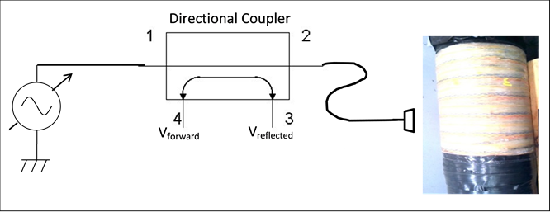

  2nd Generation Reflectometer Architecture
  One port measurement , $S_{11}=\frac{V_{reflected}}{V_{forward}}$
  Directional coupler allows for the separation of forward and reflected EM waves. Then after calibration to remove systematic errors images of variations in reflection can be built up.
  Frequency diversity eliminates ‘blind spots’.
  Calibration gives repeatability.

Slide 8
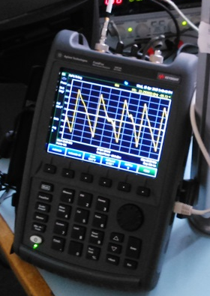
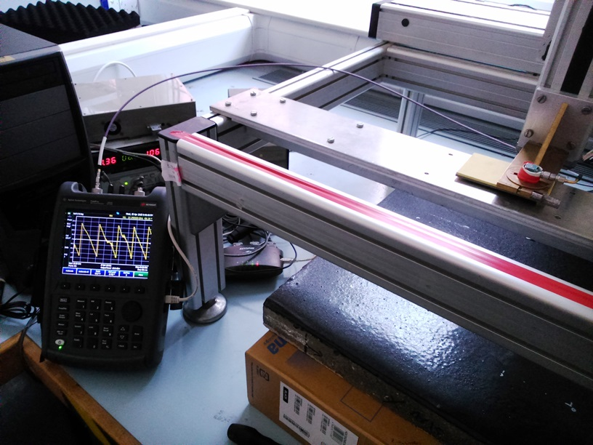
2015 – 2018 Robust, Portable Vector Analysis Test Setup
Handheld Vector Network Analyser – Keysight Fieldfox
XYZ scanning platform, motor drives and an
Full Vector Measurement capable, multiple ports.

Slide 9
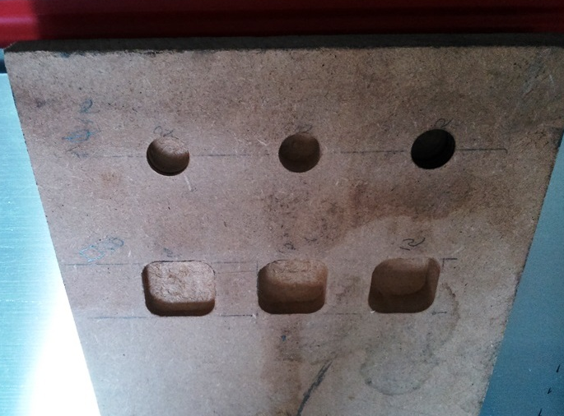
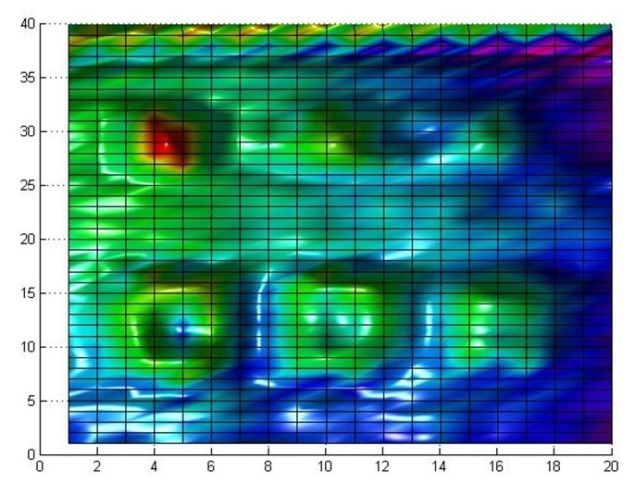
  Machined MDF Demonstration
  Inspected from flat reverse side against a metal sheet at standard UT speed 40cm x 20cm scan:

Slide 10
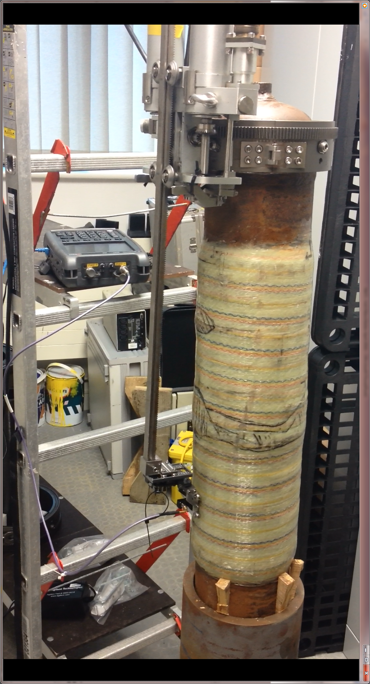

  So mounted on a GFRP Steel Pipe Wrap
  Using a Nautilus pipe scanner (with Sonomatic) and a Keysight Fieldfox vector network analyser.
  Multi-frequency scan (no blind spots)

Slide 11
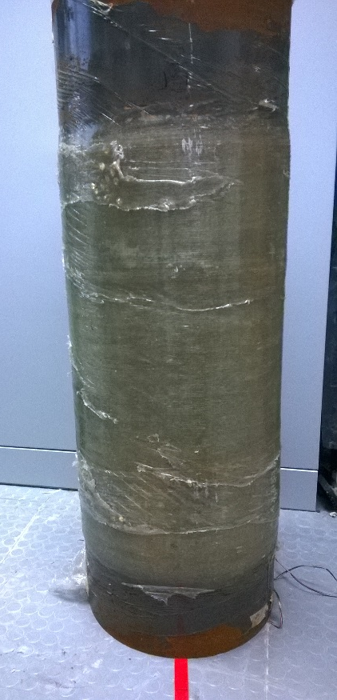
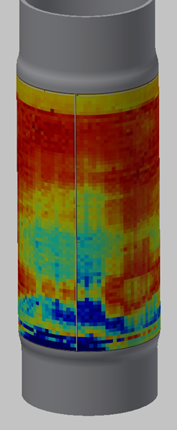
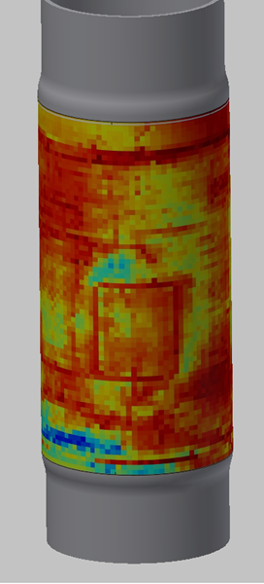
  Used on a Glass Fibre Wrap
  Steel diameter 322mm, steel thickness 9.5mm, GFRP wrap diameter 340mm, GFRP thickness ~8mm.
  Using a course step (10mm) to give a quick scan.

Slide 12
  Used on a Glass Fibre Wrap
  Steel diameter 322mm, steel thickness 9.5mm, GFRP wrap diameter 340mm, GFRP thickness ~8mm.
  Using a course step (10mm) to give a quick scan.
Anomaly evident here

Slide 13
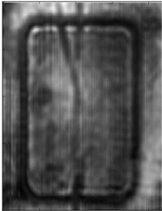
  Used on a Glass Fibre Wrap
  Steel diameter 322mm, steel thickness 9.5mm, GFRP wrap diameter 340mm, GFRP thickness ~8mm.
  Using a fine step to see fine detail of the anomaly.
  Higher resolution scan revealed a feature of around 200 mm square with radiused corners. This could be a milled pocket with wire running to it (Strain Gauge?)

Slide 14
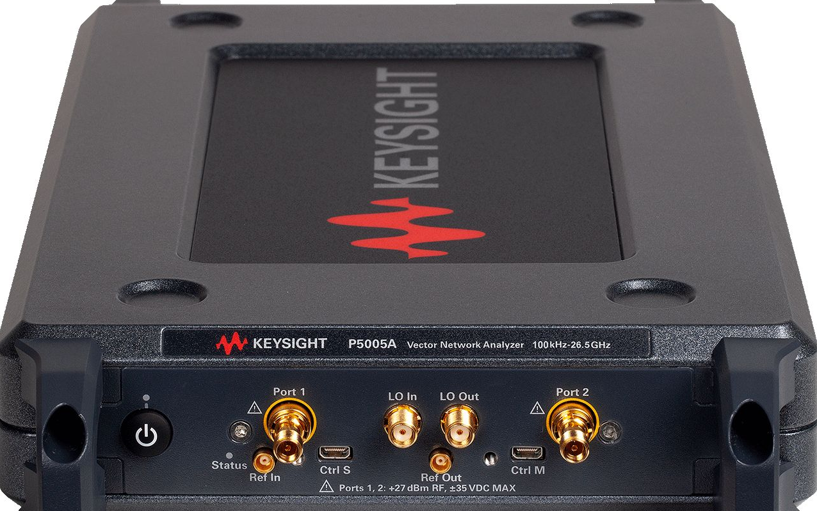
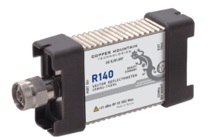
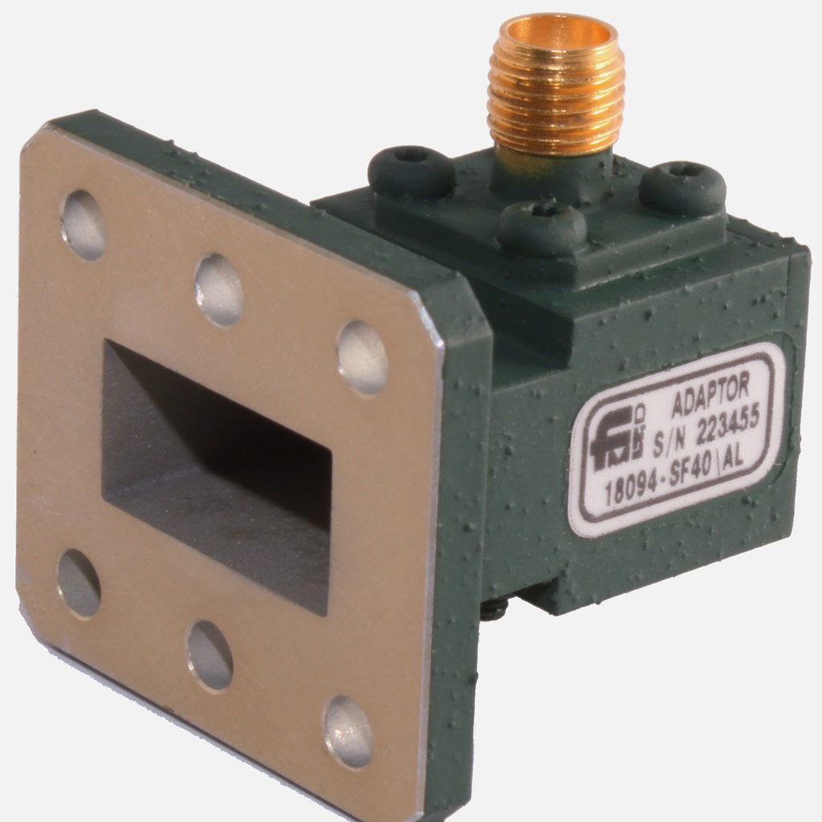

  3rd Generation Reflectometer Architecture
  One port measurement , $S_{11}=\frac{V_{reflected}}{V_{forward}}$
  Same VNA architecture but Fieldfox system is physically big.
  Equipment manufacturers develop more compact analysers.
    Keysight USB Streamline Copper Mountain & Anritsu/ R&S
    (2 & 4 –port up to 53 GHz) (1 and 2 port up to 44GHz)
  And the default probe used was standard rectangular waveguide:
    Why would this be optimal?
    EM fields have been evident in travelling laterally from the waveguide port
            Fields are not well confined
            EM Spot size is limited by the waveguide used which determines frequency.
            So can we engineer a better probe with better field confinement?

Slide 15
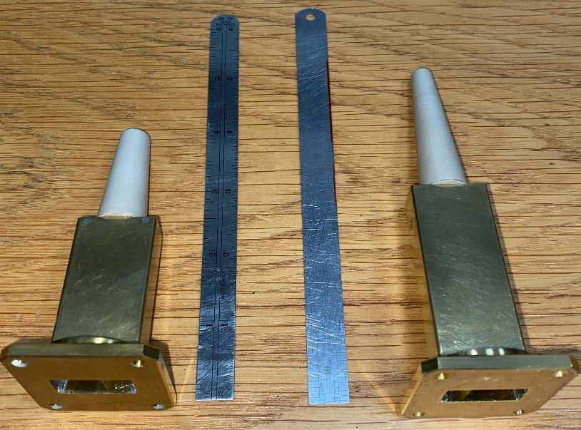
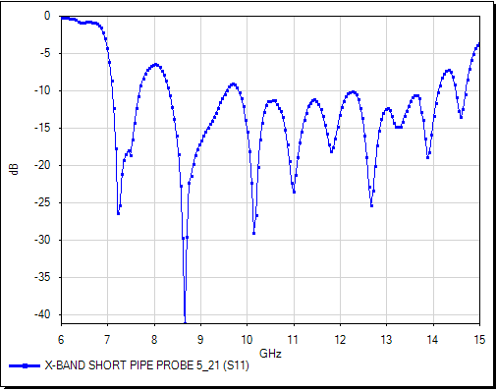
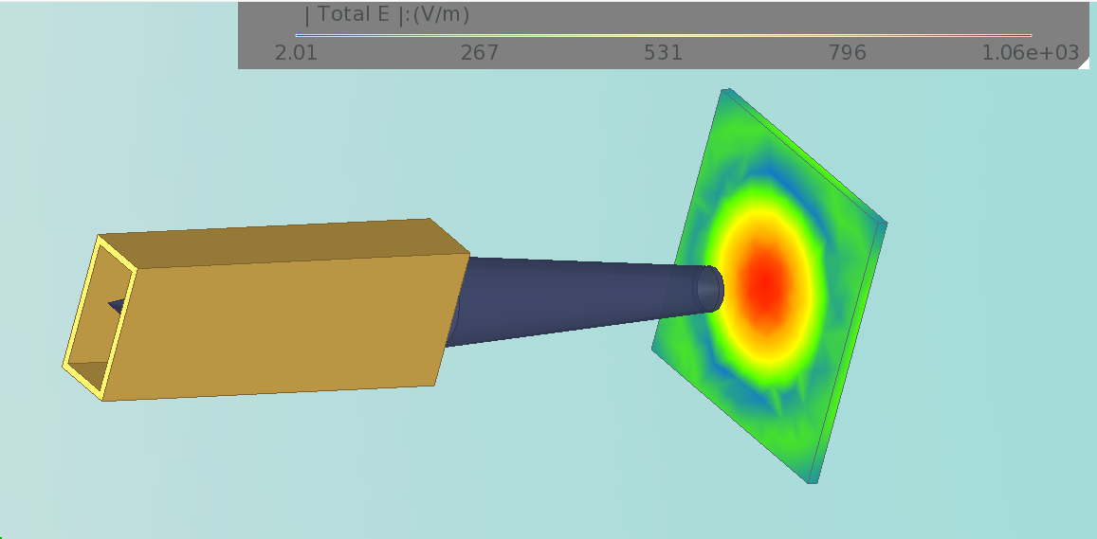
  Probe Development
  So to confine the fields the probe was designed to transition from TE10 waveguide mode to a hybrid EM mode capable of propagating down and low-loss dielectric.
  These are X-band up to ~16 GHz probes:
  Two probes from WG16 confining field down to a smaller spot size, here about 10 mm. Better confinement will yield better resolution.
  EM field plot at 12 GHz

Slide 16
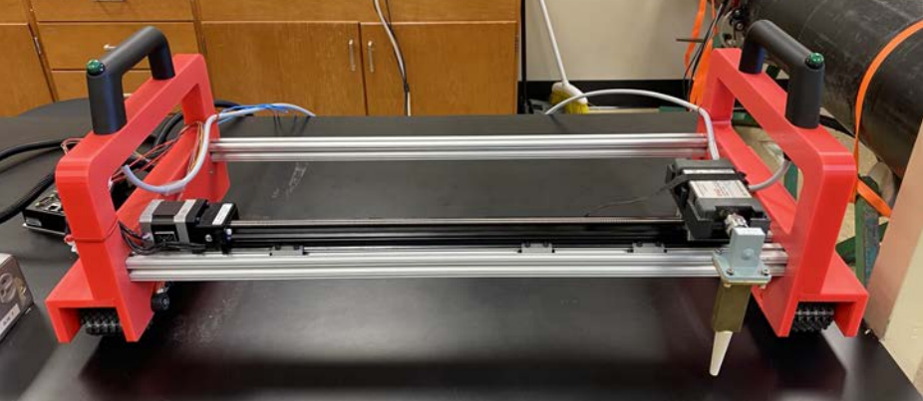
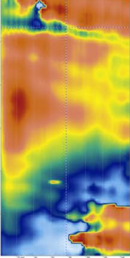
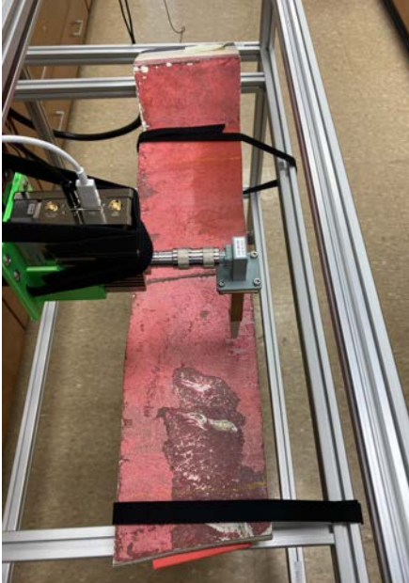
  Probe Deployment
  Mounted on a Advanced Microwave Imaging, Motorized Axis Portable Scanner (MAPS) System:
              Scanning a hull sample
Crack

Slide 17
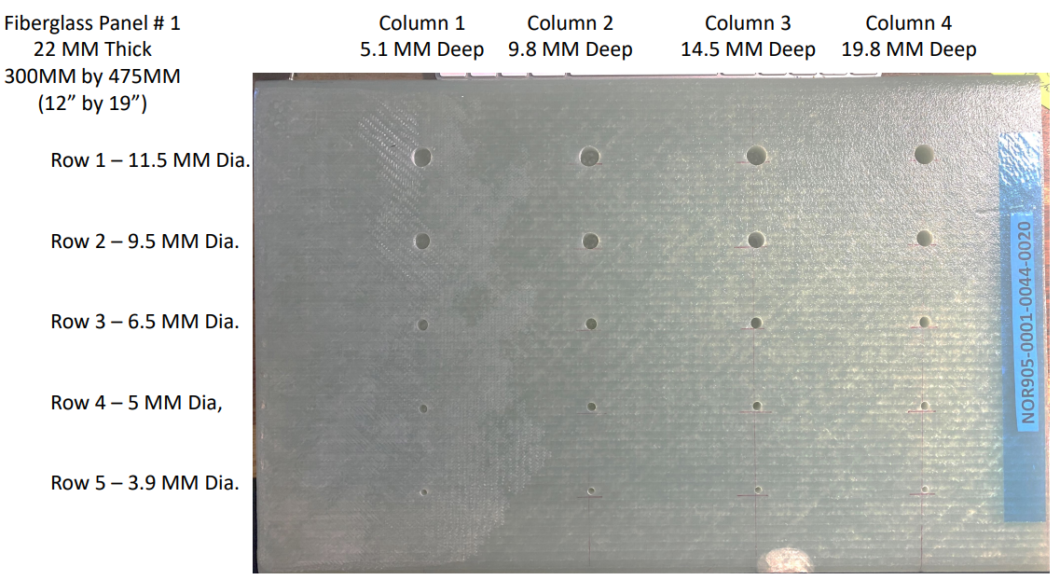
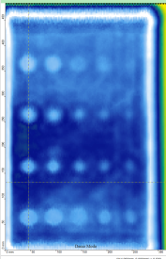
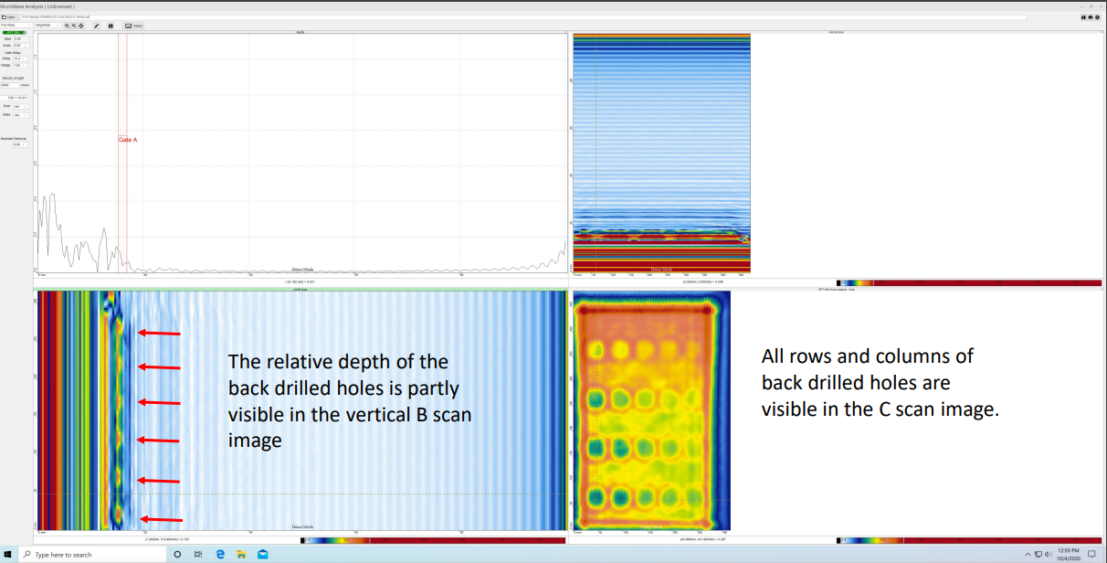
  Probe Deployment
  Scanning
  Courtesy of Bob Stakenborghs
  Of Advanced Microwave Imaging

Slide 18
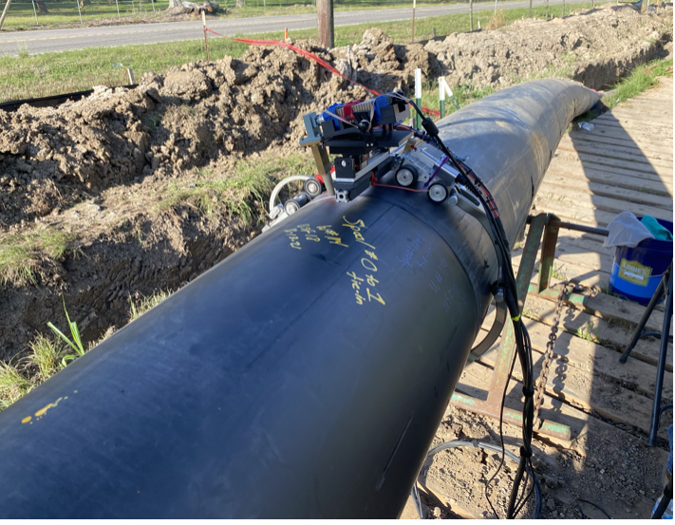
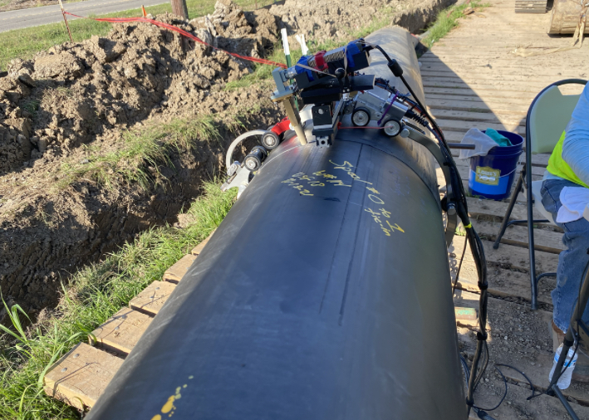
  Probe Deployment on HDPE Butt fusions
  Scanning up to today -14 days scanning to prove out a pipeline.

Slide 19
  MICROWAVE NDT – NEXT BIG THING in NDT?
  ASNT Microwave Techniques Committee has been set up Oct 2013. Body of knowledge being defined. Heavily influenced by early standing wave radar system – ASNT Standard SNT-TC-1A. Level III Microwave NDT qualified staff are based in US.
  UK BINDT has reconstituted a THz Committee (met August 2021).
  Lots of techniques and research to be explored. Can depth to flaw be measured with high resolution? Frequency dependent resolution requiring ultra-broadband probes, but there are analysers in the pipeline that will enable reflectometer measurements to 300 GHz.
  What about similar techniques such as SAR, FFT on broadband frequency data to move to time domain (depth) or synthetic pulsed time domain solutions?

Slide 20
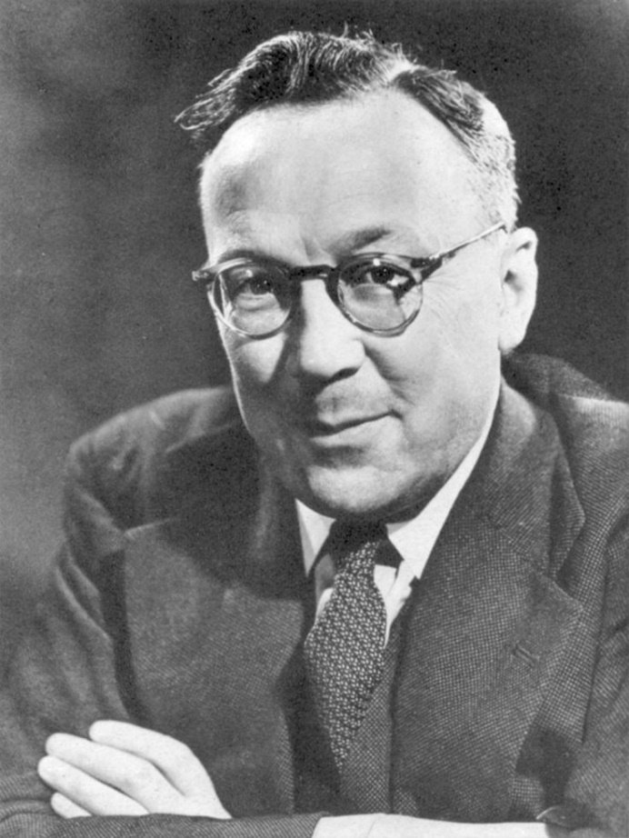
  MICROWAVE NDT – NEXT BIG THING in NDT?
  Question is have we passed: ‘Minimum Viable Product’?
  Thank - you
Give me the third best technology. The second best won’t be ready in time. The best will never be ready.
Robert Watson-Watt

Slide 21
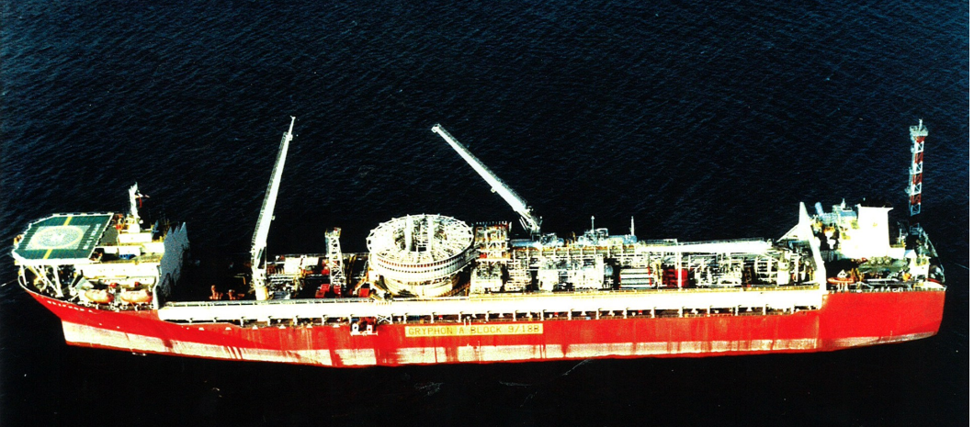
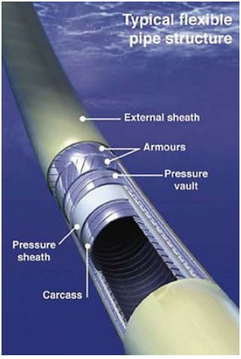
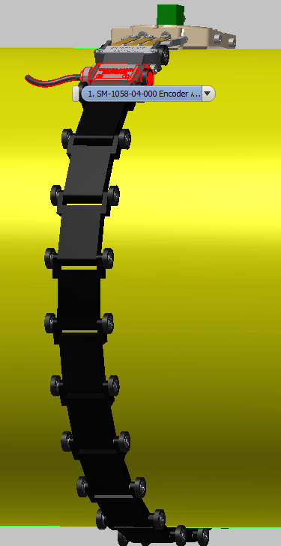
  Inspection of Outer Armour in the Flexible Piping
  Gryphon Alpha – production fluids carried in flexible pipes
Scan arrangement

Slide 22
  Inspection of Outer Armour in the Flexible Piping
  Trials on flat metal bars beneath a plastic board. Bars have varying spacing. Promising results but more work to do:

Slide 23
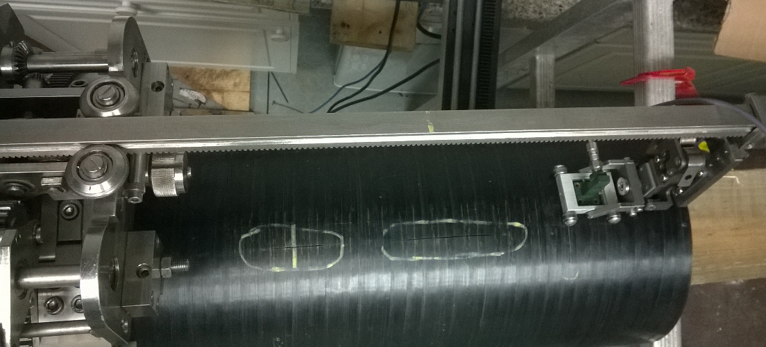
  On CFRP pipe
  Carbon fibre loaded polymer pipe
  Microwave penetration is limited to a few mms at the very most, depending on the pipe composition.

Slide 24
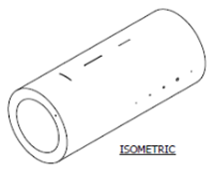
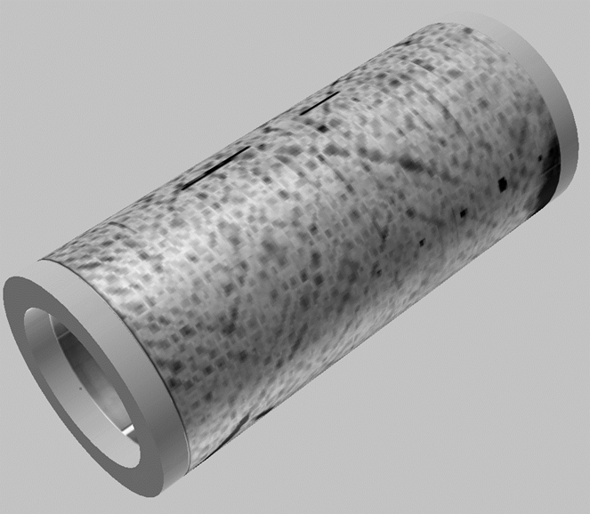
  On CFRP pipe
  Some slots & holes were milled into the pipe

Slide 25
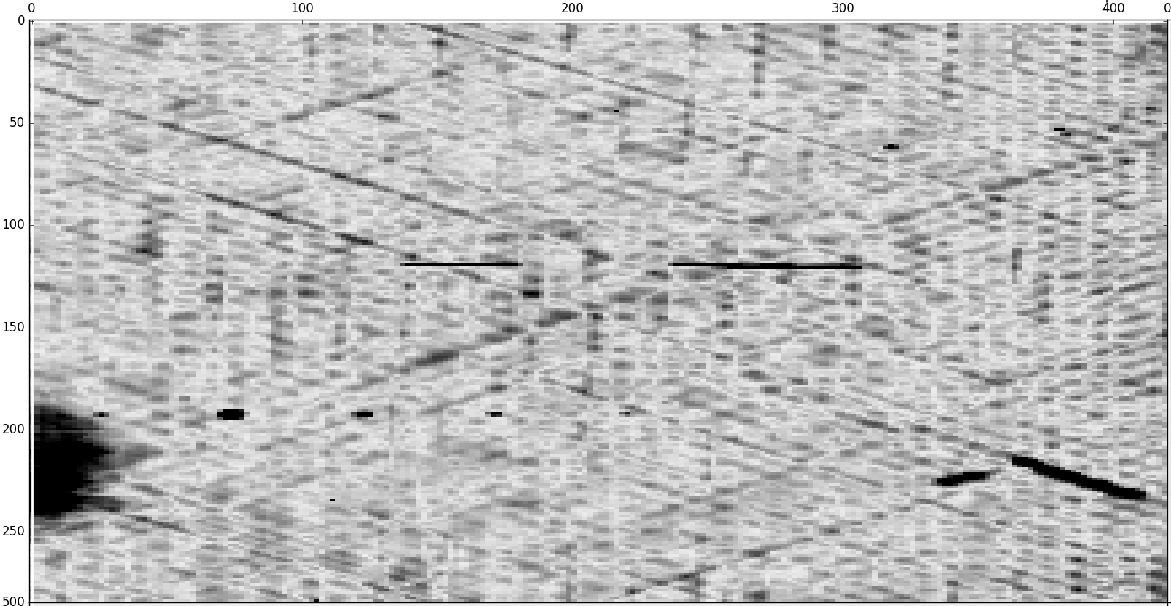
  On CFRP pipe
  These showed up on scan
slots
weave
holes
weave

Slide 26
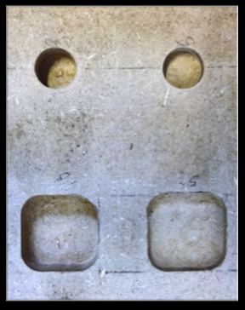

  Radiometer System with Teratech Components
  Transmission Measurement through MDF
  Using a broadband noise source from 75 -105 GHz to illuminate the samples
  Holes at varying depths

Slide 27
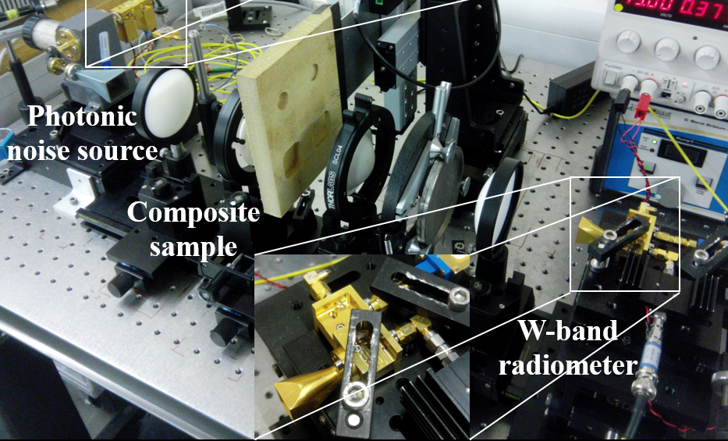
  Radiometer System with Teratech Components
  W-band Radiometer receiver

Slide 28
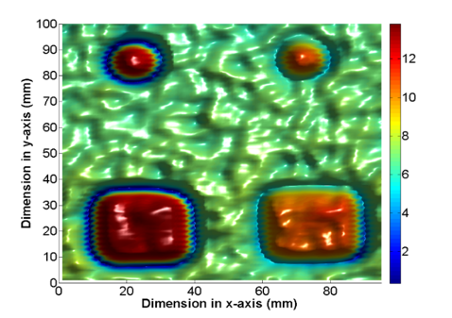
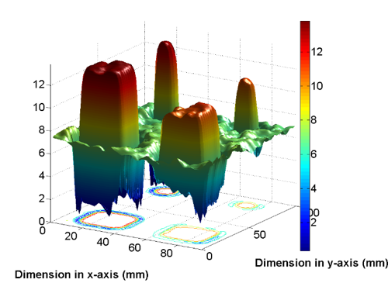
  Radiometer System with Teratech Components
  Co-polar transmission
  Measurement: plan view
Peaks correspond to thickness of MDF

Slide 29
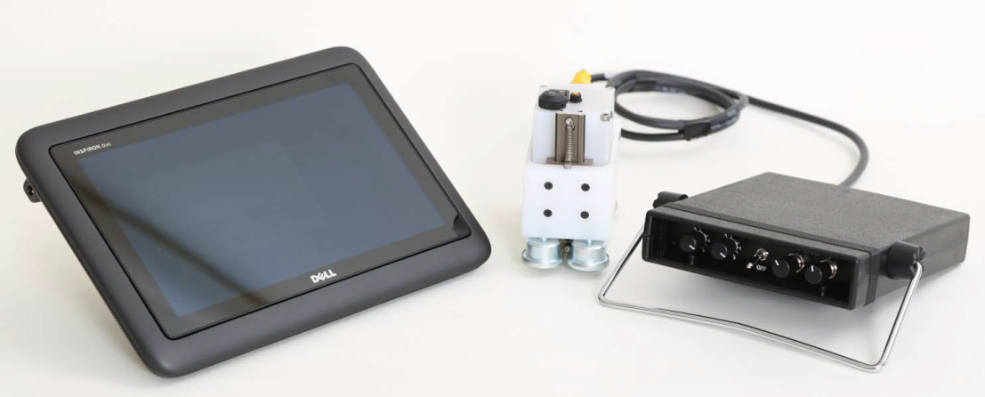
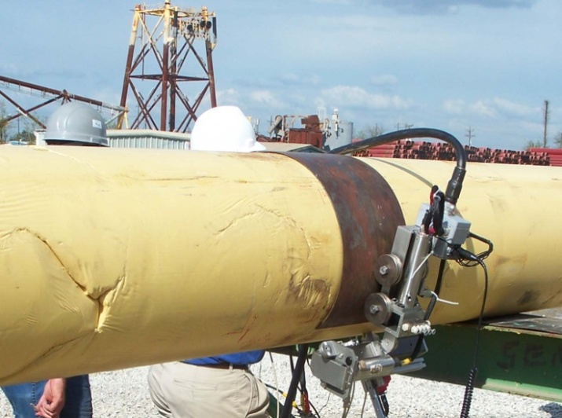
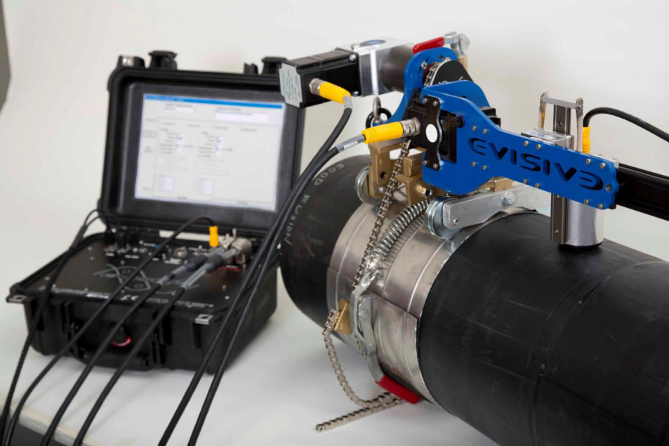
  The Current Evisive System – Based in Baton Rouge
  Single frequency system
  Mounted on a HDPE joint

Slide 30



  Evisive Ceramic Armor Microwave Imaging
  Photo of ceramic armor X-ray shot of the ‘broken’ armor
  Microwave Scanned image on
  Evisive System

Slide 31


  THz System – Picometrix, LLC (Ann Arbor, Michigan)
  Time domain system using fast pulses
  Frequencies used – broadband 0.05 – 4THz
  Based on several PhDs research
  Picometrix System Radome Image with disbond

